Slide 1
Protection
Operating System Concepts

Slide 2
Protection
Operating system consists of a collection of objects, hardware or software
Each object has a unique name and can be accessed through a well-defined set of operations.
Protection problem - ensure that each object is accessed correctly and only by those processes that are allowed to do so.
Operating System Concepts

Slide 3
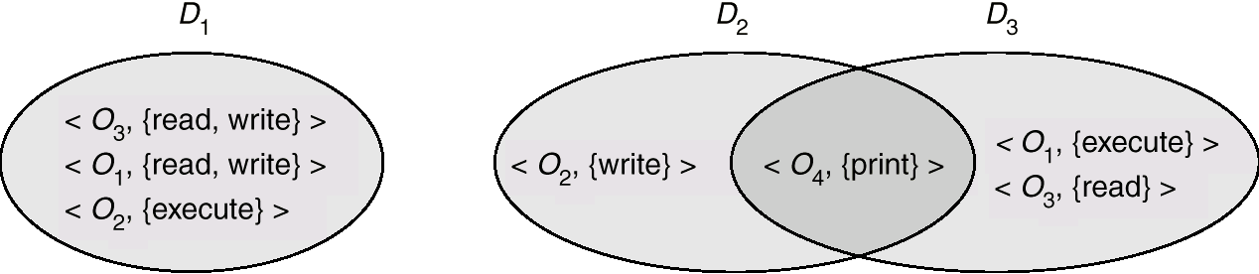
Domain Structure
Access-right = <object-name, rights-set>
where rights-set is a subset of all valid operations that can be performed on the object.
Domain = set of access-rights
Operating System Concepts

Slide 4
Access Matrix
View protection as a matrix (access matrix)
Rows represent domains
Columns represent objects
Access(i, j) is the set of operations that a process executing in Domain_{i} can invoke on Object_{j}
Operating System Concepts

Slide 5
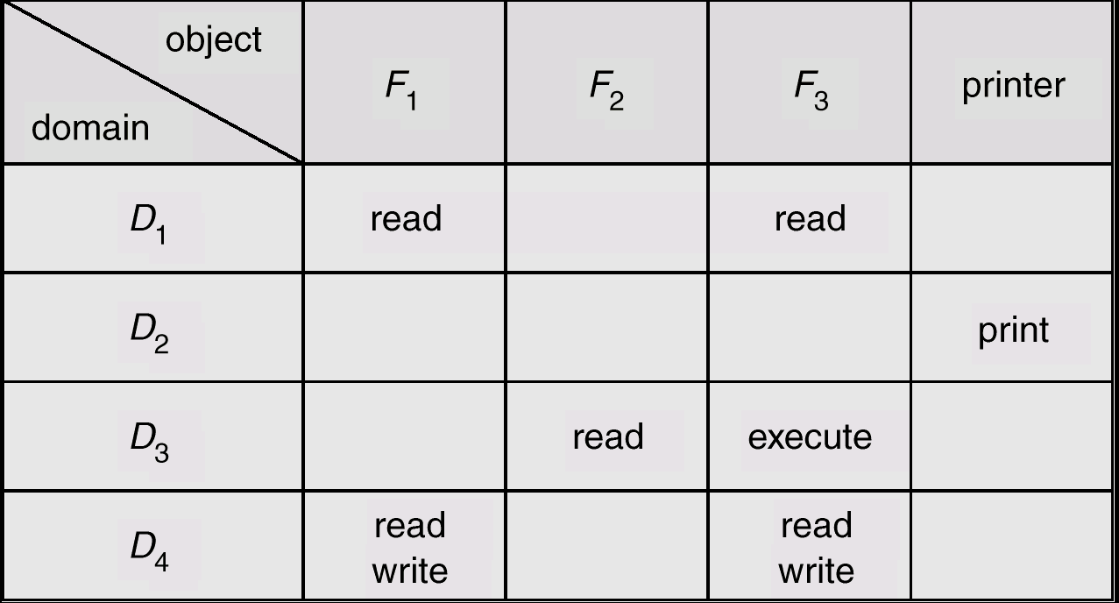
Access Matrix
Figure A
Operating System Concepts

Slide 6
Use of Access Matrix
If a process in Domain D_{i} tries to do “op” on object O_{j}, then “op” must be in the access matrix.
Can be expanded to dynamic protection.
  Operations to add, delete access rights.
  Special access rights:
    owner of O_{i}
    copy op from O_{i} to O_{j}
    control – D_{i} can modify D_{j} access rights
    transfer – switch from domain D_{i} to D_{j}
Operating System Concepts

Slide 7
Use of Access Matrix (Cont.)
Access matrix design separates mechanism from policy.
  Mechanism
    Operating system provides access-matrix + rules.
    OS ensures that the matrix is only manipulated by authorized agents and that rules are strictly enforced.
  Policy
    User dictates policy.
    Who can access what object and in what mode.
Operating System Concepts

